Slide 1
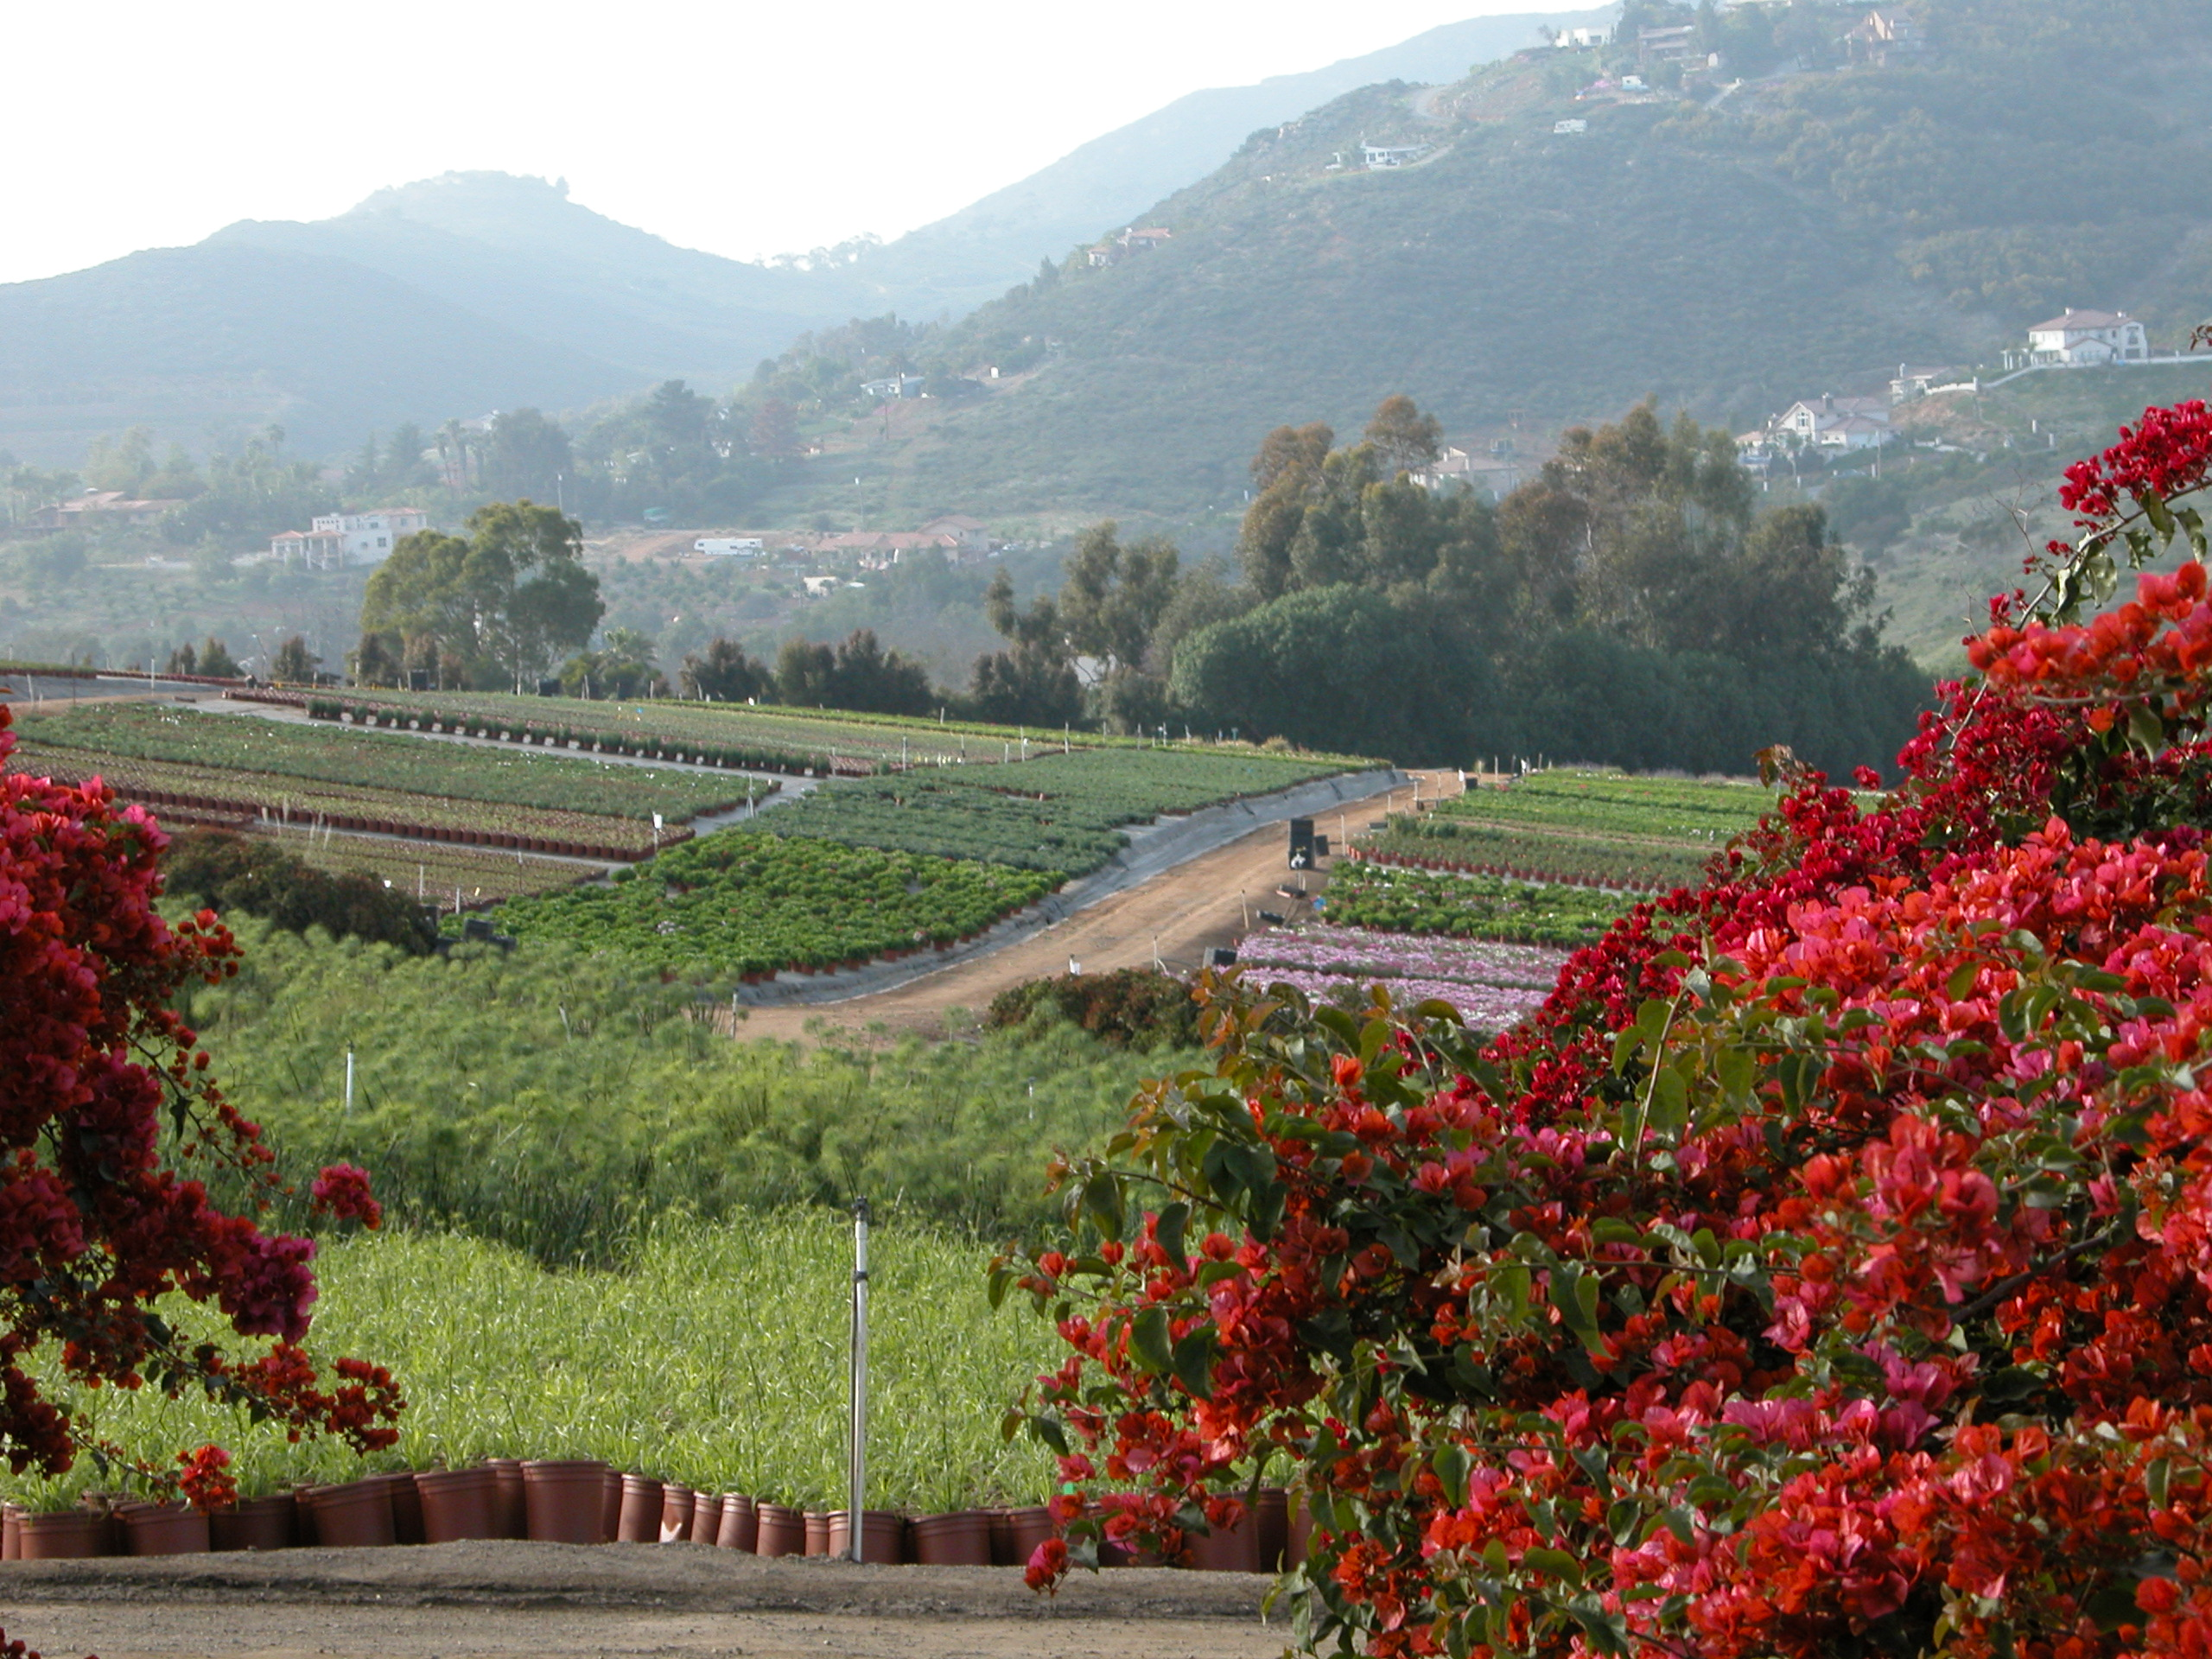

All information contained is confidential.
© 2010 Altman Plants
January 2010

